Slide 1
Math Pacing
Entrance Ticket
Learning Targets
Quick Check
Pacing Plan
Mini-Tests
Exit Ticket

Slide 2
32.1 Entrance Ticket
What are your goals for the math test on the ACT®? How do you plan to achieve them? What could stand in your way?
Answer these questions in complete sentences.
Entrance Ticket
Learning Targets
Quick Check
Pacing Plan
Mini-Tests
Exit Ticket

Slide 3
32.2 Learning Targets
Set a personalized pacing goal for the math test based on ACT scoring tables
Follow a personalized pacing plan for the math test
Self-Assessment
Circle the number that corresponds to your confidence level in your knowledge of this subject before beginning the lesson. A score of 1 means you are completely lost, and a score of 4 means you have mastered the skills. After you finish the lesson, return to the bottom of this page and circle your new confidence level to show your improvement.
Entrance Ticket
Learning Targets
Quick Check
Pacing Plan
Mini-Tests
Exit Ticket

Slide 4
32.2 Quick Check
How many minutes are you given on the ACT Math test?
60 minutes
How many questions?
60 questions
Where do the most difficult questions appear?
Toward the end, usually the last 15
Where do the easiest ones appear?
Toward the beginning, usually the first 15
What is a scaled score?
The score you receive on the actual ACT test
What is a raw point?
The point you get when you answer one question correctly
Entrance Ticket
Learning Targets
Quick Check
Pacing Plan
Mini-Tests
Exit Ticket

Slide 5
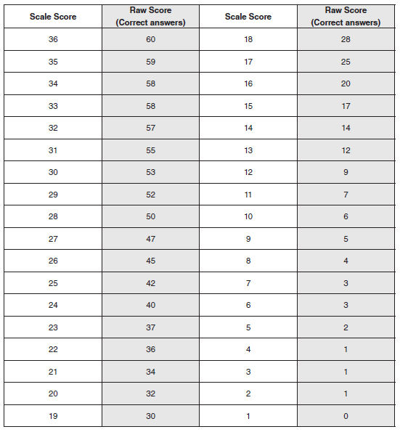
32.3.1 Setting a Pacing Plan
Entrance Ticket
Learning Targets
Quick Check
Pacing Plan
Mini-Tests
Exit Ticket

Slide 6
32.3.1 Setting a Pacing Plan
Goal Scale Score:____________
Overall Goal Raw Score:_____________
Pacing Strategy Chosen:_____________
Target Raw Score (1–10):_____________
Actual Raw Score (1–10):_____________
Target Raw Score (11–20):_____________
Actual Raw Score (11–20):_____________
Target Raw Score (21–30):_____________
Actual Raw Score (21–30):_____________
Target Raw Score (31–40):_____________
Actual Raw Score (31–40):_____________
Target Raw Score (41–50):_____________
Actual Raw Score (41–50):_____________
Target Raw Score (51–60):_____________
Actual Raw Score (51–60):_____________
Entrance Ticket
Learning Targets
Quick Check
Pacing Plan
Mini-Tests
Exit Ticket

Slide 7
Entrance Ticket
Learning Targets
Quick Check
Pacing Plan
Mini-Tests
Exit Ticket

Slide 8
32.5 Exit Ticket
No exit ticket for this lesson.
Entrance Ticket
Learning Targets
Quick Check
Pacing Plan
Mini-Tests
Exit Ticket

Slide 9
This publication, its author, and its publisher are in no way affiliated with or authorized by ACT, Inc. ACT® is a copyright and/or trademark of ACT, Inc.
Learning Targets

